Slide 1
HEART DISEASE ANALYSIS AND PREDICTION
By: Aaron, Harshal, and Ethan (Group 11, FCED)

Slide 2
01
02
03
04
05
MOTIVATION
Sample Collection & Problem Formulation
DATA PREPARATION
Cleaning the Data
EXPLORATORY ANALYSIS
Summarise, Visualise, & Gain Insights from Data
MACHINE LEARNING
Criteria and methods for choosing models.
EVALUATION & CONCLUSION
How the model's performance will be measured.
Notes:
Based on the data pipeline

Slide 3
01
MOTIVATION
You can enter a subtitle here if you need it

Slide 4
PROBLEM DEFINITION & MOTIVATION
Heart disease is one of the leading causes of mortality globally, accounting for 1/3 of deaths or 18,500,000 per year. The ability to predict and prevent life-threatening heart attacks could save countless lives
Goal: To predict occurrence of heart disease early for early treatment and management

Slide 5
The Dataset
Openly sourced dataset retrieved via Kaggle
Cleveland CAD dataset from the
University of California Irvine (UCI).
From the clinical and noninvasive test results of patients undergoing angiography at the
Cleveland Clinic in Ohio
Notes:
Talk abt data set we chose

Slide 6
02
DATA PREPARATION
You can enter a subtitle here if you need it

Slide 7
DATA CLEANING
01 | OUTLIER DETECTION
 |  | May disrupt the Machine Learning process
02 | MISSING VALUE ANALYSIS
 |  | Removed all entries with any missing variable
03 | DUPLICATE REMOVAL
 |  | May skew data

Slide 8
03
DATA EXPLORATION
Factors that increase heart attack risk

Slide 9
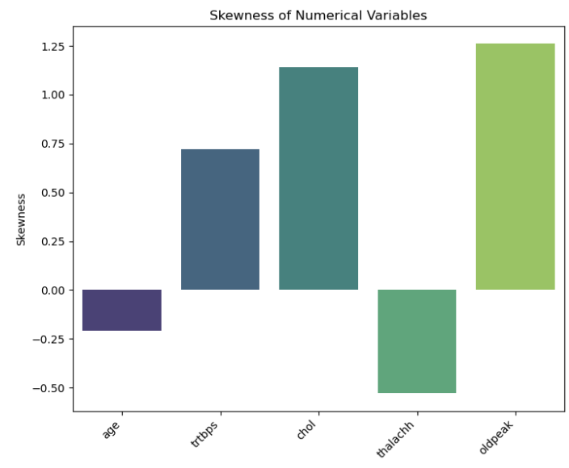
Uni Variate Graphical Analysis
Cholesterol levels showed a notable right skew, with values ranging up to 564 mg/dL, far exceeding the median of 240 mg/dL.
Old Peak also showed a notable positive skew

Slide 10
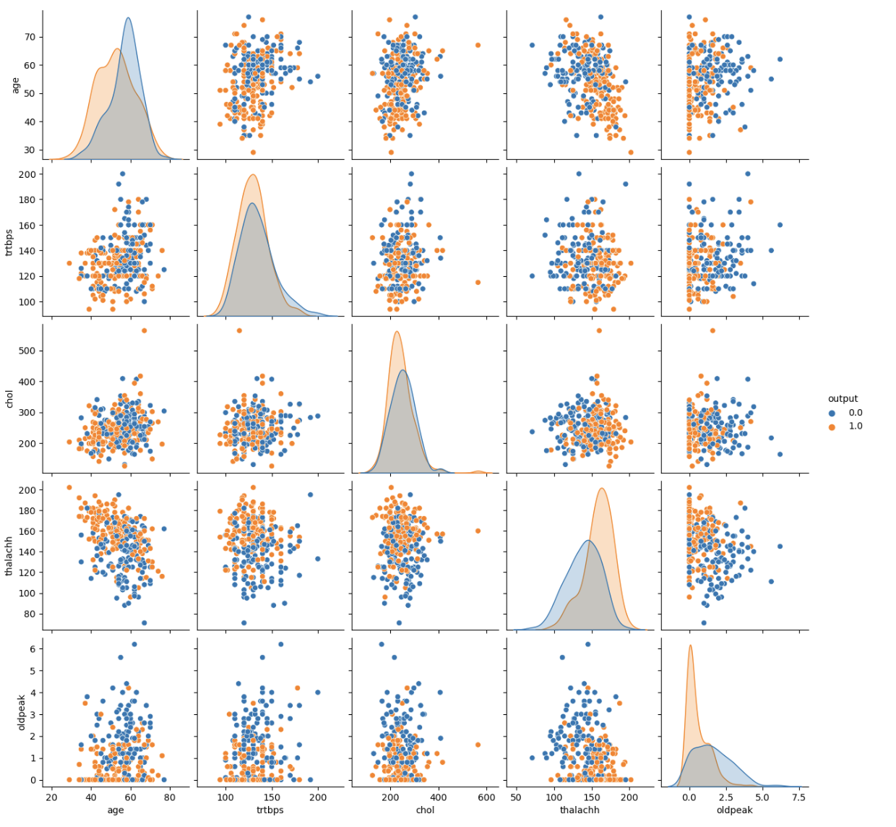
Bi Variate Analysis
There was a moderate positive correlation of 0.28 between age and systolic blood pressure, indicating that blood pressure tends to rise with age.
A correlation coefficient of 0.44 between cholesterol levels and the presence of heart disease underscored cholesterol as a key risk factor.

Slide 11
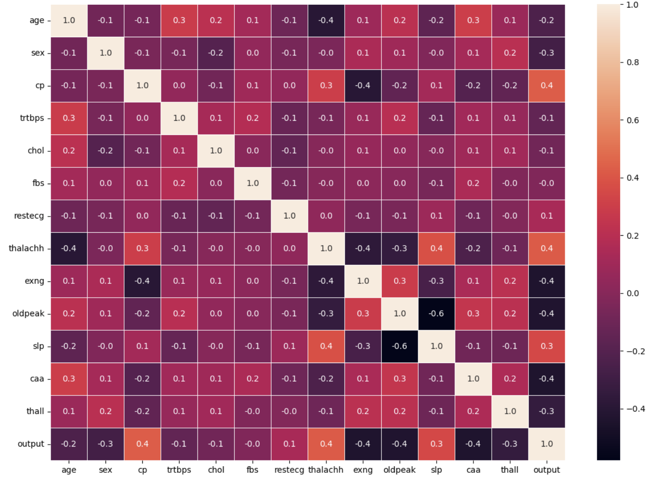
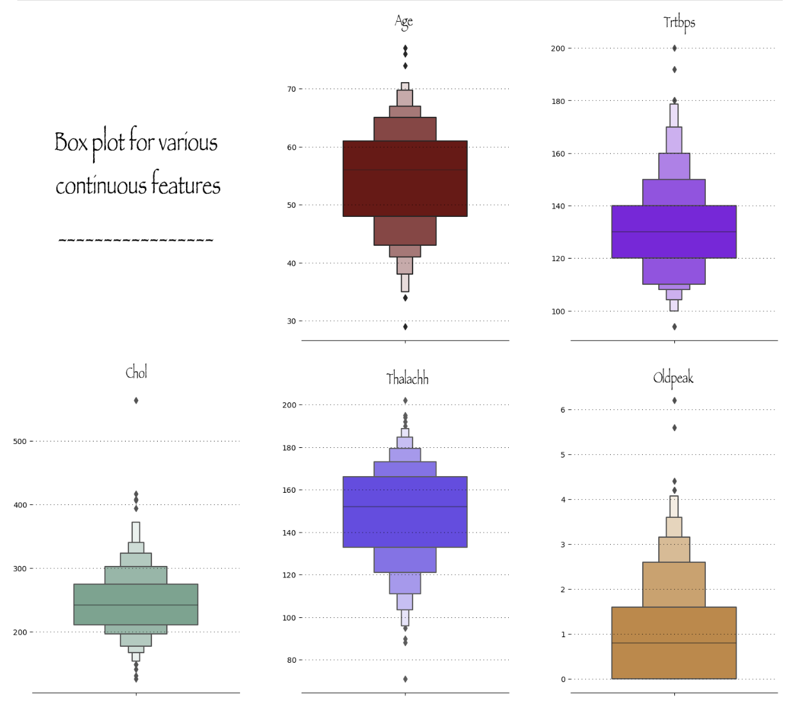
Box plots and swarm plots were instrumental in identifying outliers and assessing distribution characteristics. For example, systolic blood pressure values above 170 mmHg were outliers, affecting roughly 5% of the database.

Slide 12
04
MACHINE LEARNING

Slide 13
MACHINE LEARNING
01 | Logistic Regression
02 | Decision Tree Classifier
03 | Random Forest Classifier

Slide 14
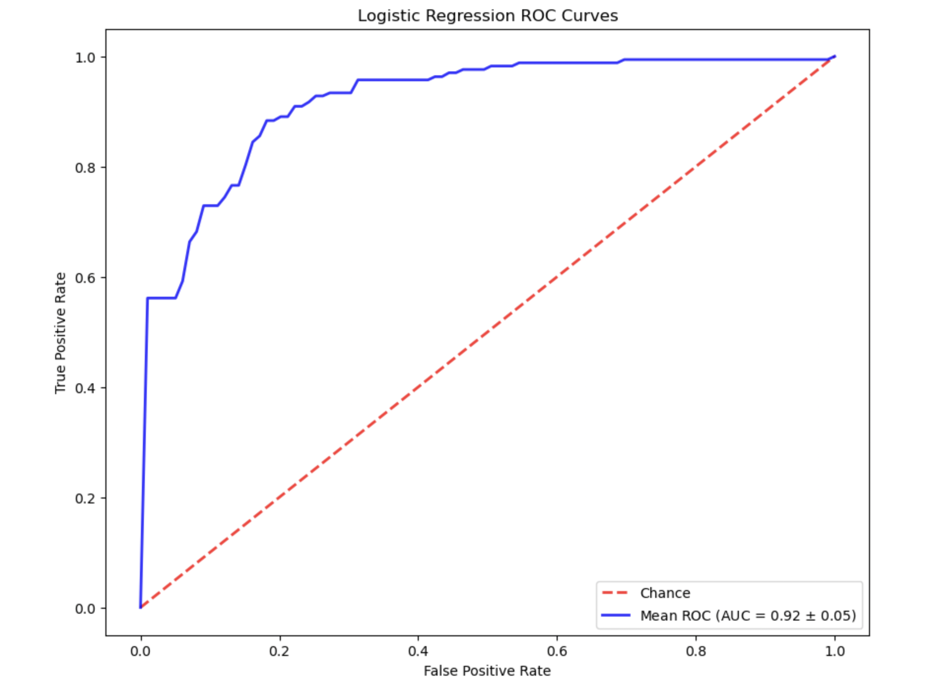
Logistic Regression
Logistic regression: statistical method for binary classification
Predicts probability of data point belonging to category
Fits logistic curve to data, limits output probabilities between 0 and 1
Suitable for binary outcome models
Estimates regression coefficients to maximize likelihood of observed data
Can be regularized to prevent overfitting
Enables better generalization to unseen data

Slide 15

Gridsearch CV
Hyperparameter Space Definition: Define a grid of parameters to test, encompassing various combinations.
Cross-Validation Setup: Employ cross-validation, splitting the dataset into folds for training and validation.
Model Evaluation: Train and evaluate the model for each parameter combination across the cross-validation folds.
Selection of Best Parameters: Identify the combination with the highest average performance across all folds.

Slide 16
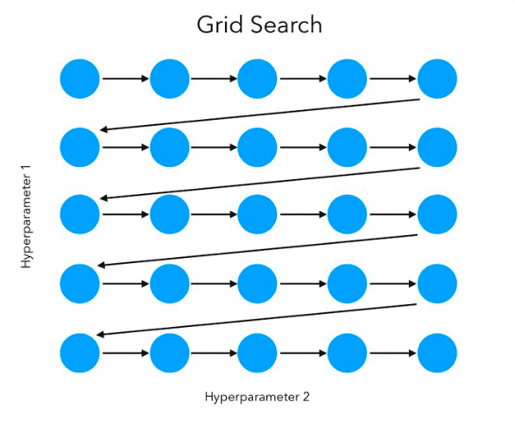
K fold Cross Validation
Dataset Division: Divide the dataset into k consecutive folds, typically 10.
Validation Rotation: Each fold serves as the validation set once, with the remaining k - 1 folds as the training set.
Repetition: Repeat the process k times, using each fold as validation exactly once.
Result Aggregation: Average or combine the results from all folds to obtain a single estimation.

Slide 17
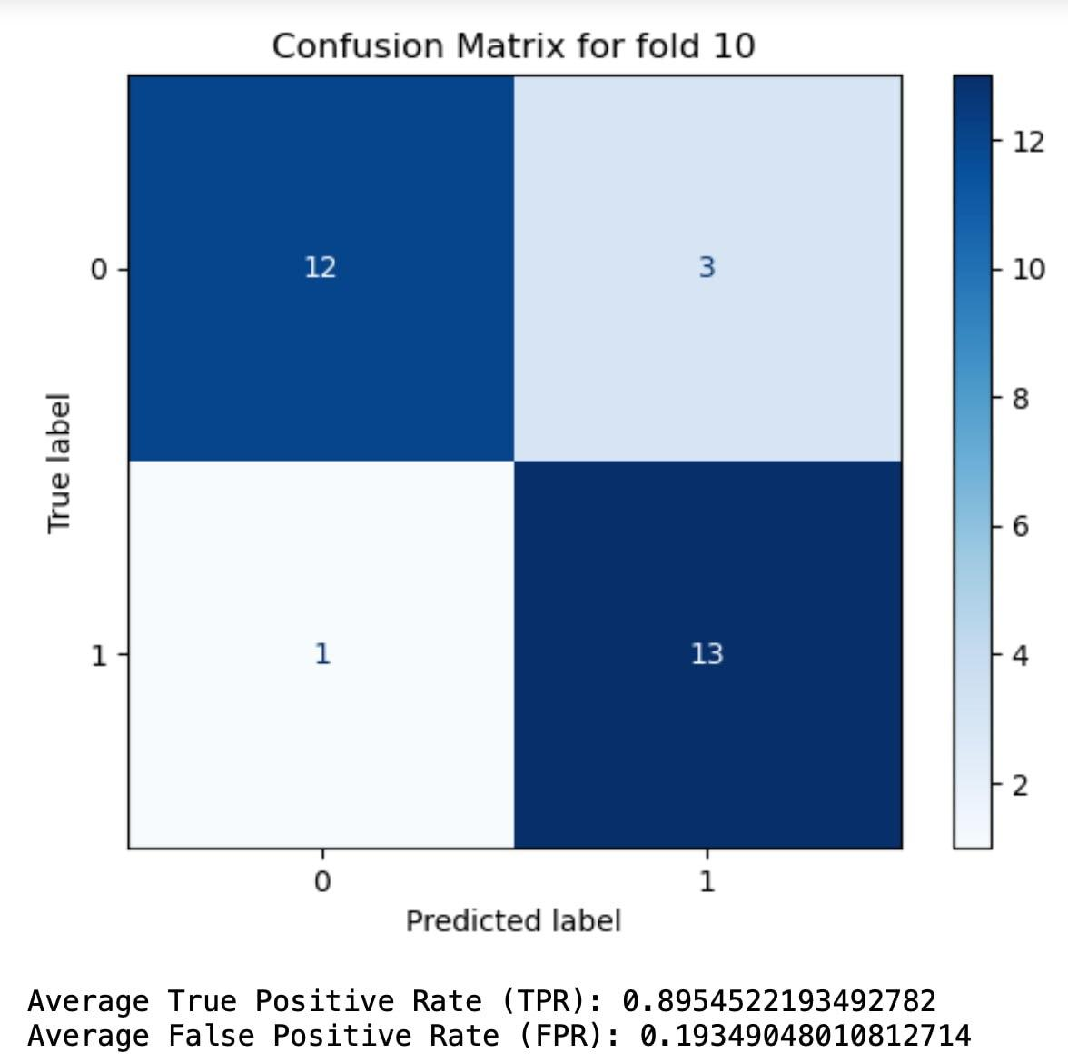
K fold Cross Validation
Average True Positive Rate (TPR): 0.8954522193492782
Average False Positive Rate (FPR): 0.19349048010812714
CV Accuracy mean: 0.8554022988505748

Slide 18
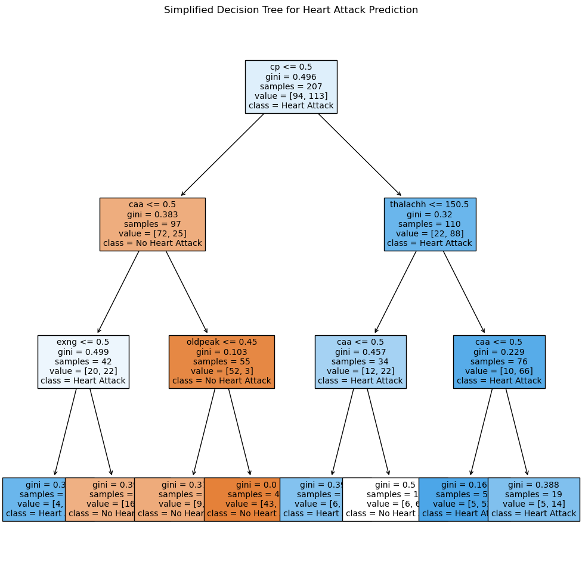
Decision Tree Classifier
Functionality: Predicts the value of a target variable.
Decision Rules: Learns simple decision rules based on data features.
Structure: Represented as a tree structure.
Internal Nodes: Denote features.
Branches: Represent decision rules.
Leaf Nodes: Correspond to outcomes.
Accuracy: 0.8333333333333334

Slide 19
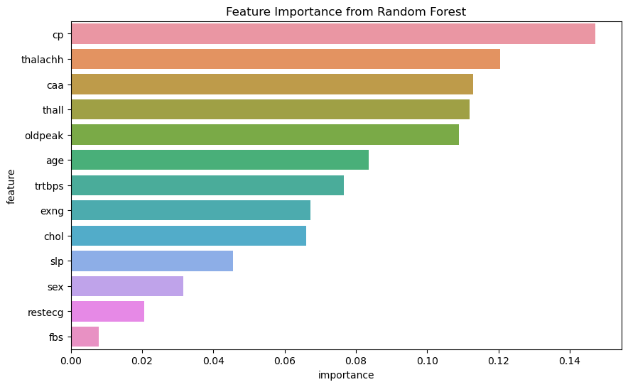
Random Forest Classifier
Random Forest Classifier: Ensemble learning method for classification (and regression).
Construction of Decision Trees: Builds multiple decision trees during training.
Output Determination: Output class is the mode of classes of individual trees (classification).
Improved Prediction: Merges multiple trees for more accurate and stable predictions
Accuracy: 0.8666666666666667

Slide 20
05
EVALUATION & CONCLUSION

Slide 21
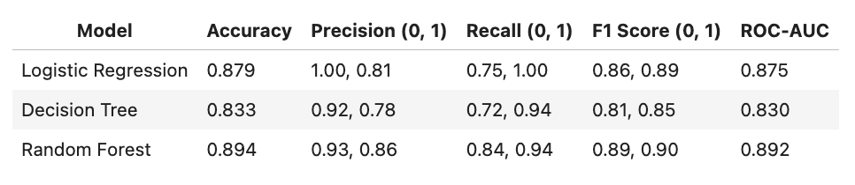

Slide 22
REFERENCES
https://www.kaggle.com/code/kanncaa1/heart-attack-analysis-prediction (link to download the dataset)
https://archive.ics.uci.edu/dataset/45/heart+disease (info about dataset)

